Slide 1
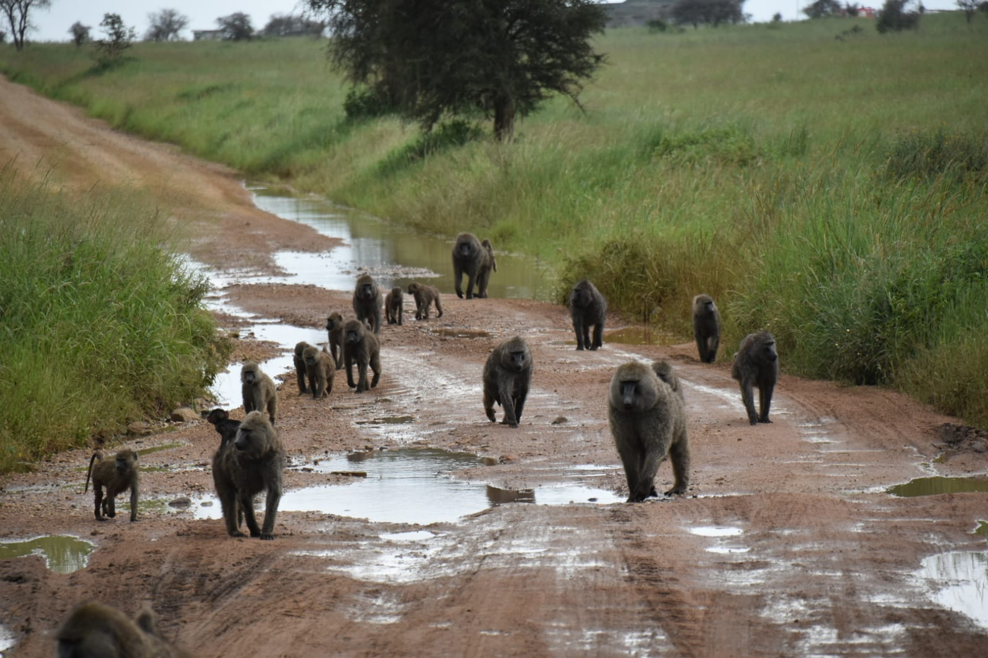
Milestone 1 : Workshop in Computational Analysis of the Microbiome
Tomer Oron & Yuval Dotan

Slide 2
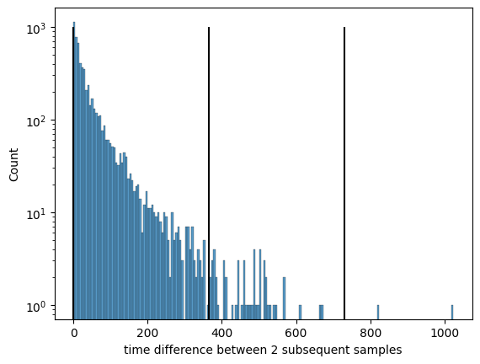
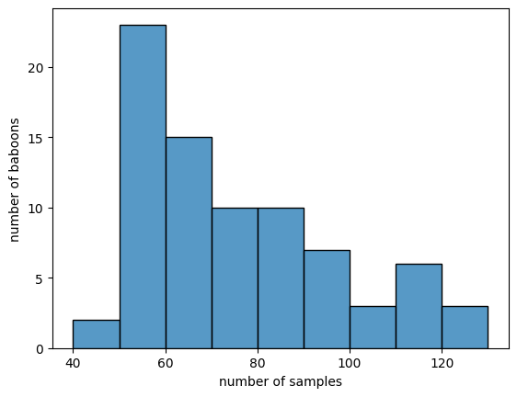
The Data
We have 6,096 samples taken from 80 baboons - 76.2 samples per baboon on average.
Time difference between 2 subsequent samples - 46.849 days
Notes:
107 samples taken same day

